Slide 1
WELCOME
Weekly Report
Vatsla Adhikari
Dec. 8, 2023

Slide 2
INDEX
Slide 1: Weekly Report
Slide 2: Index
Slide 3: Main Objective (Verification of 4 functions)
Slide 4: Code API Table and Summary (MTF_oneLot)
Slide 5-6: Code Output Graphs (MTF_oneLot)
Slide 7: Code API Table and Summary (CxCy_oneLot)
Slide 8: Code Output Graphs (CxCy_oneLot)
Slide 9: Code API Table and Summary (MTF_LatestNLots)
Slide 10-11: Code Output Graphs (MTF_LatestNLots)
Slide 12: Code API Table and Summary (CxCy_LatestNLots)
Slide 13: Code Output Graphs (CxCy_LatestNLots)

Slide 3
Objective: Verifying the four functions:
=> MTF_oneLot
=> CxCy_oneLot
=> MTF_LatestNLots
=> CxCy_LatestNLots

Slide 4
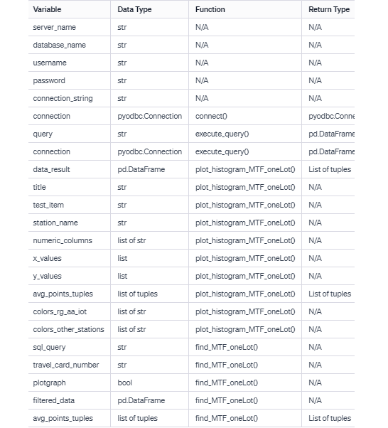
Objective: Code API Table and Summary
MTF_oneLot: API Table
Summary:
The provided Python script is designed to connect to a SQL Server database, execute a query, and visualize the results through histograms. The main functions include connect for establishing a database connection, execute_query for running SQL queries and returning results as a Pandas DataFrame, and plot_histogram_MTF_oneLot for generating histograms based on specific test items and station names.
The find_MTF_oneLot function retrieves data for a particular travel card number from the database and, if specified, plots histograms for each unique test item.

Slide 5
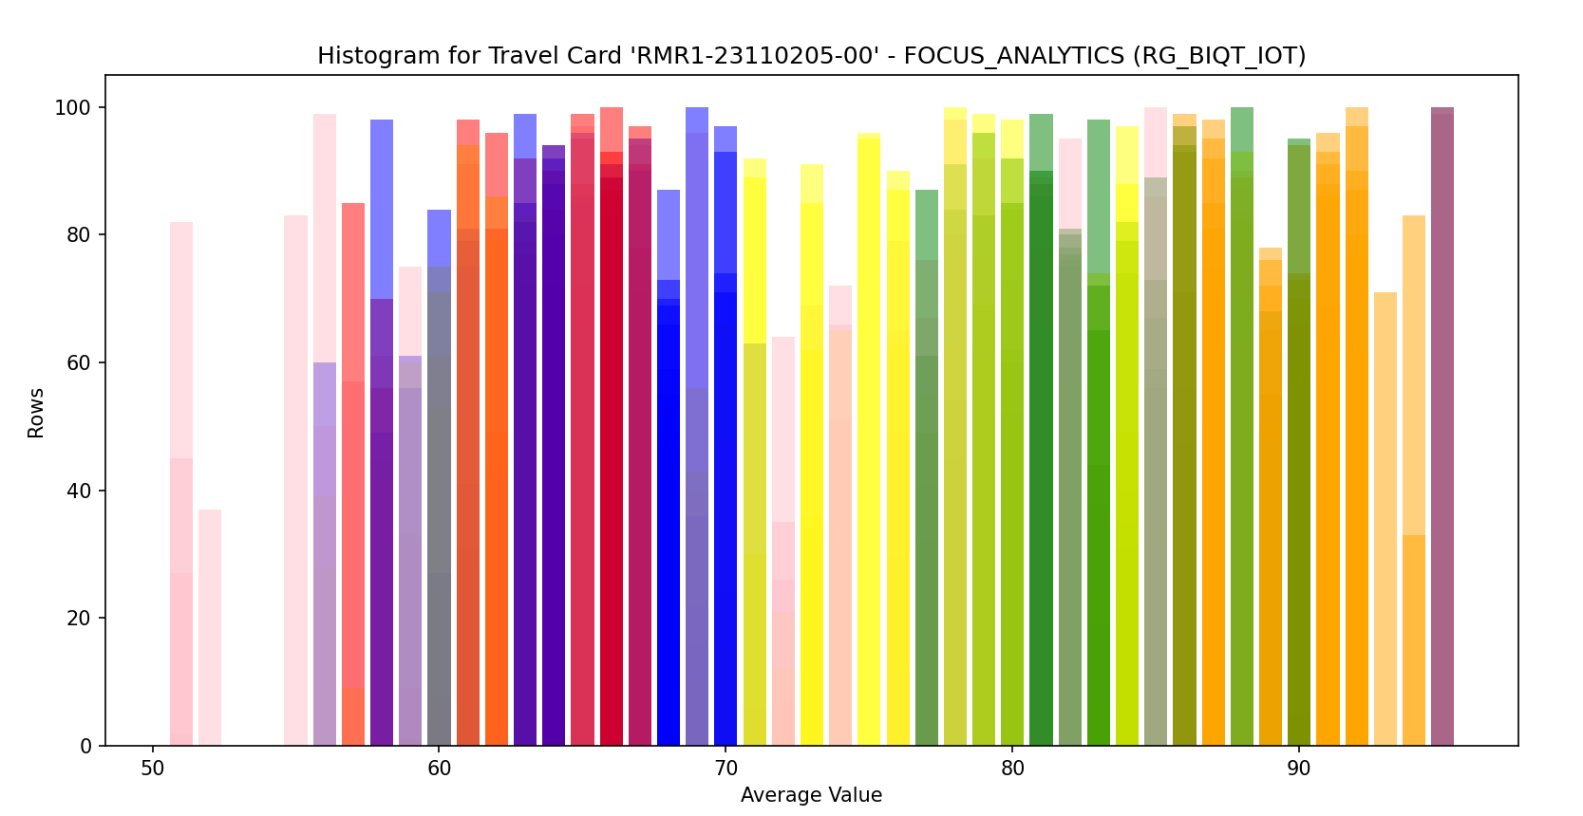
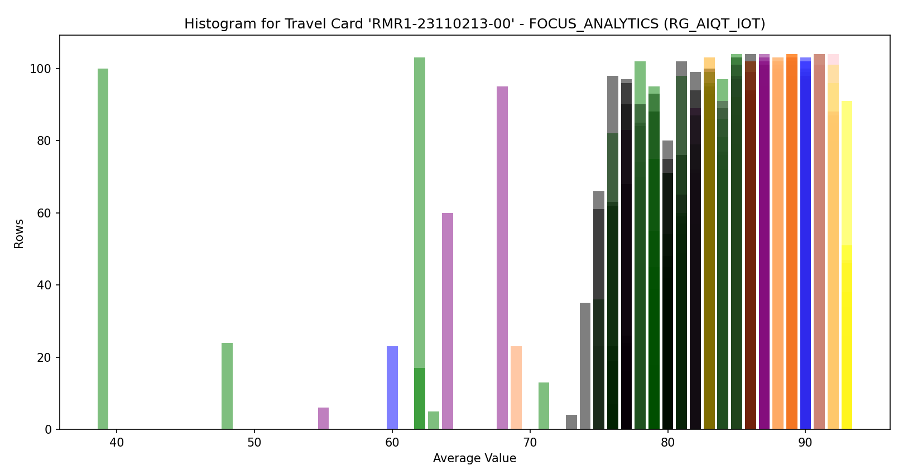
Objective: Code Output Graphs
MTF_oneLot: Output
specific_travel_card_number = 'RMR1-23110205-00'
station_name='RG_BIQT_IOT'
specific_travel_card_number = 'RMR1-23110213-00’
station_name='RG_AIQT_IOT
'

Slide 6
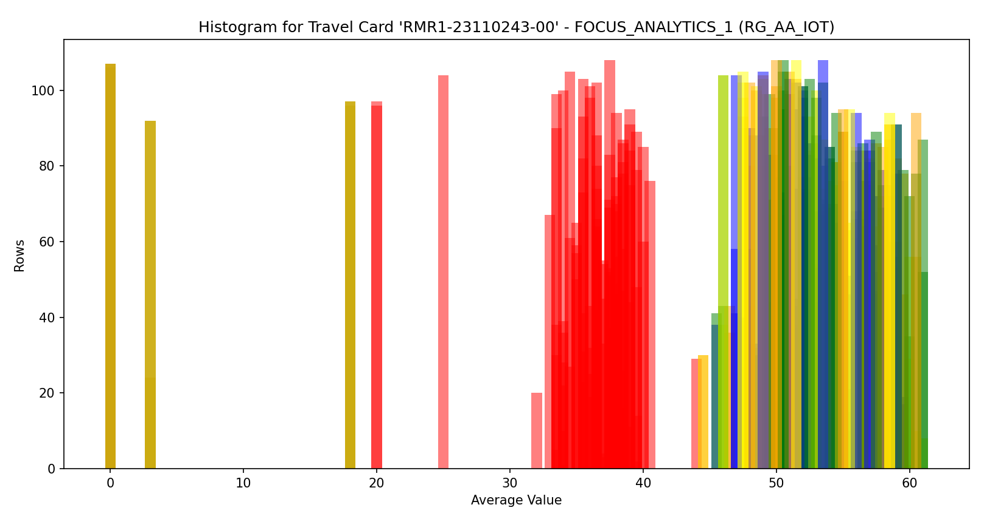
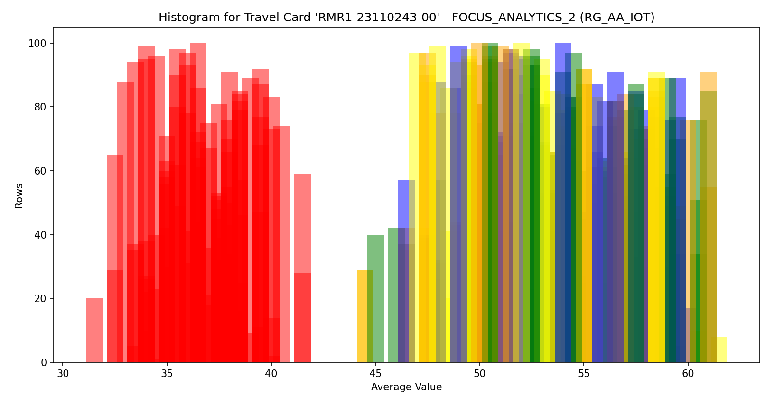
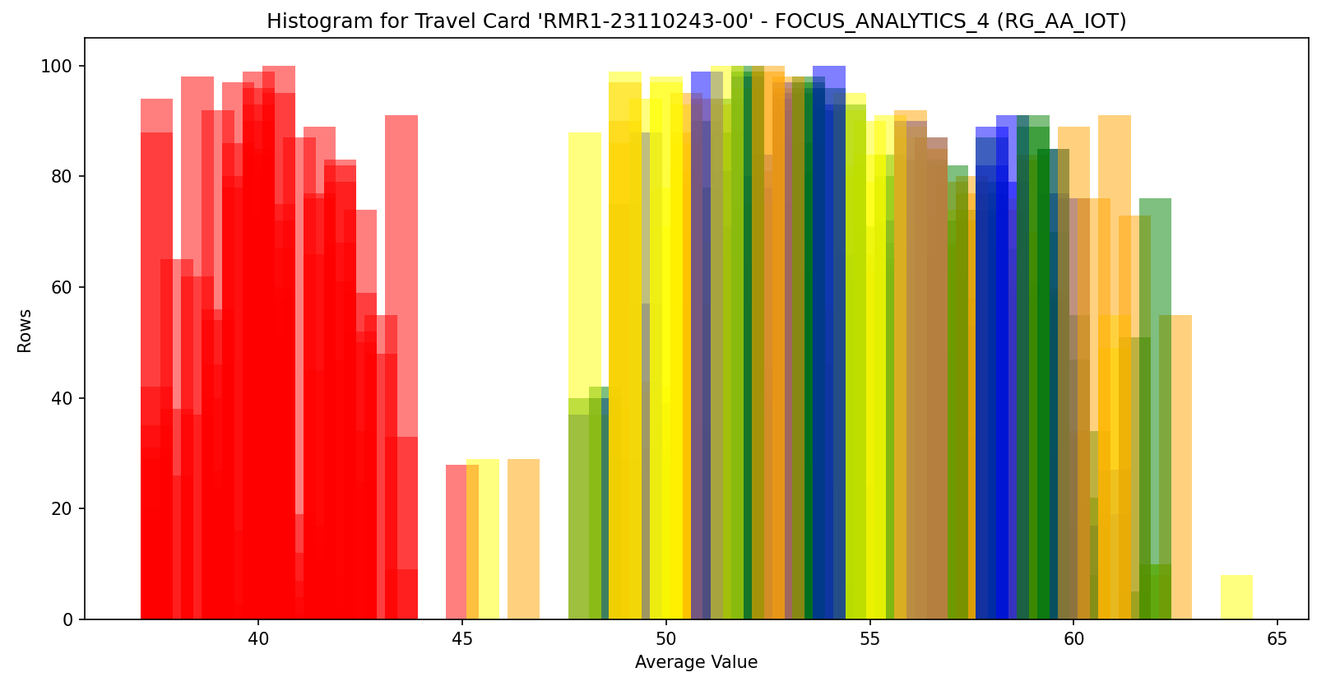
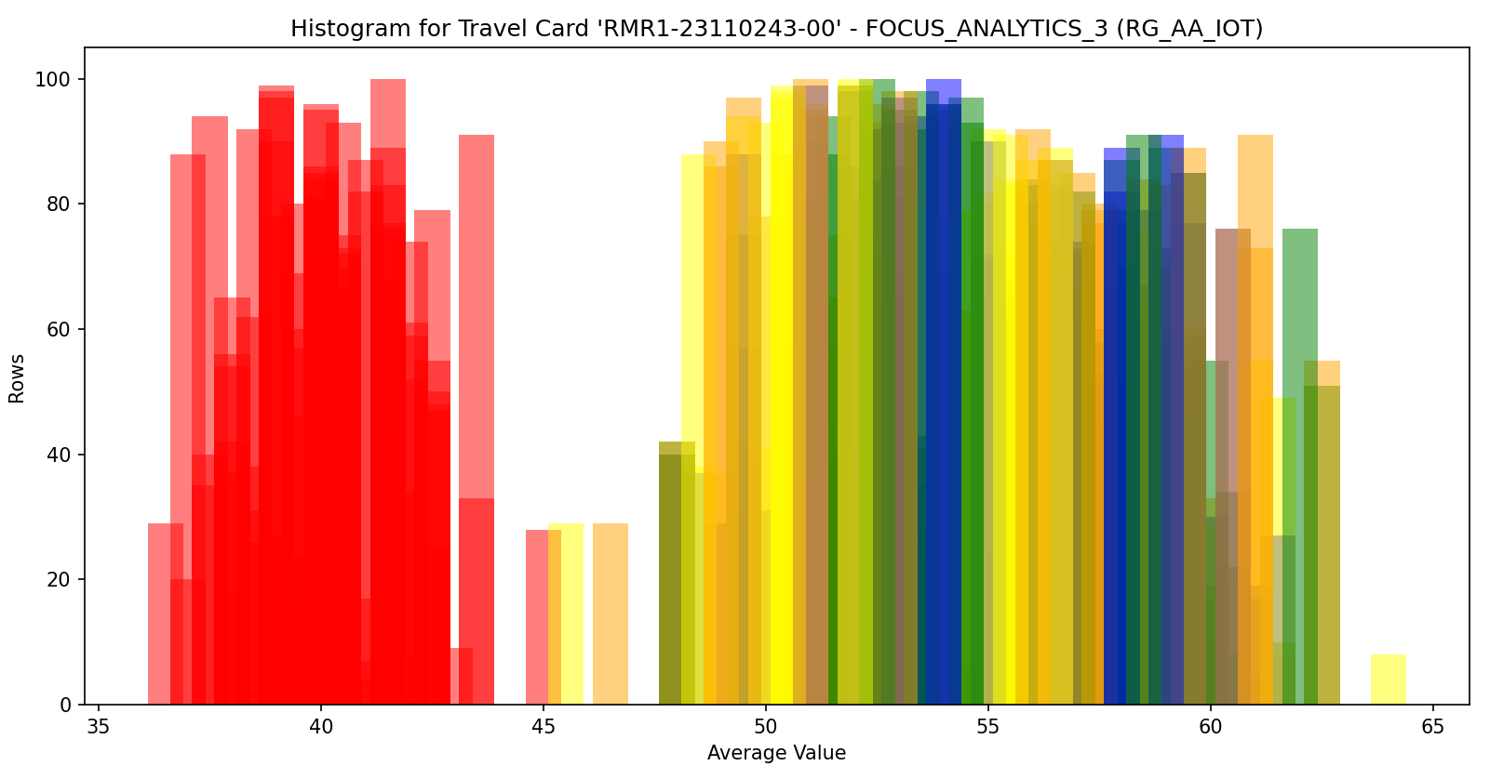
Objective: Code Output Graphs
MTF_oneLot: Output
specific_travel_card_number = 'RMR1-23110243-00’
station_name='RG_AA_IOT
'

Slide 7
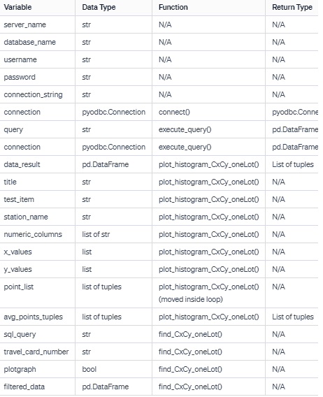
Objective: Code API Table and Summary
CxCy_oneLot: API Table
Summary:
This Python script connects to a SQL Server database, executes a query to retrieve data related to specific test items, and plots histograms for the test items related to X and Y coordinates. The main functions include connect for establishing a database connection, execute_query for running SQL queries and returning results as a Pandas DataFrame, and plot_histogram_CxCy_oneLot for generating histograms based on X and Y coordinate data.
The find_CxCy_oneLot function retrieves data for a particular travel card number from the database and, if specified, plots histograms for X and Y coordinates related to the 'FOCUS_ANALYTICS' test item.

Slide 8
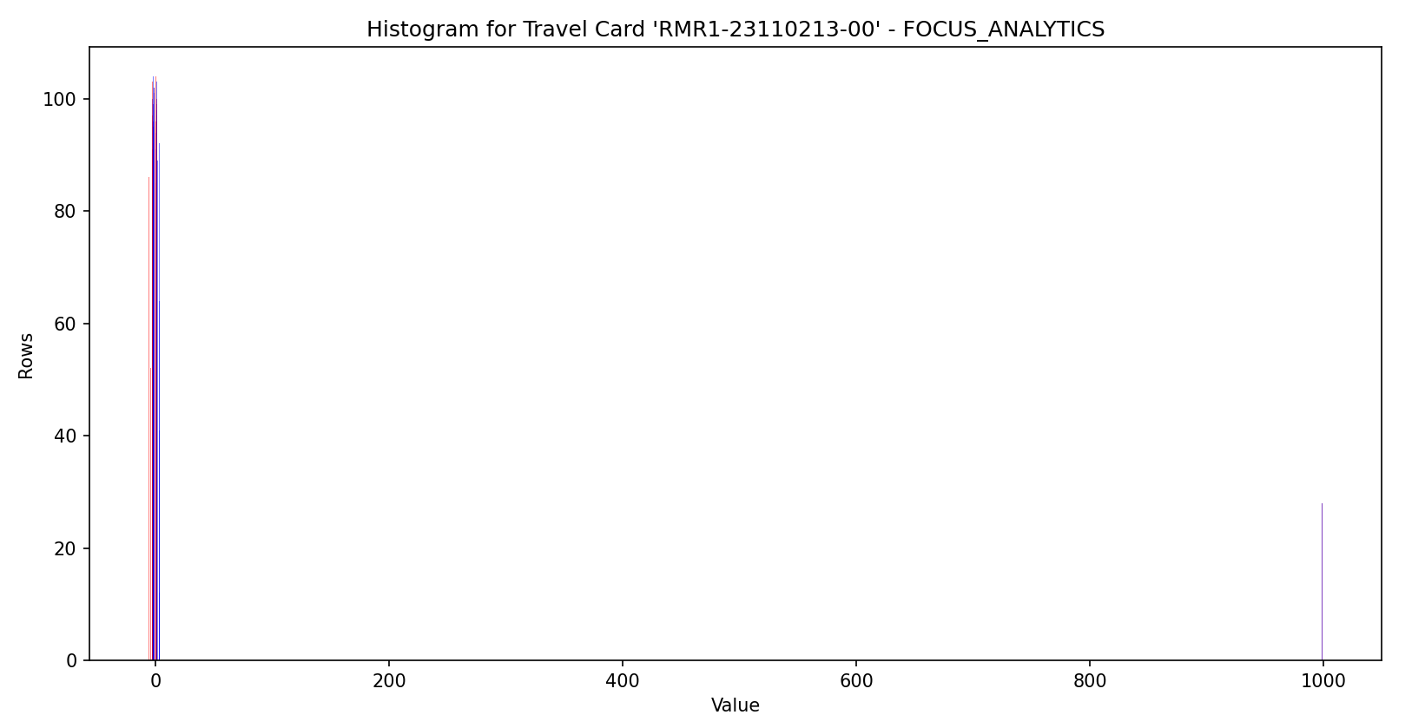
Objective: Code Output Graphs
CxCy_oneLot : Output
specific_travel_card_number = 'RMR1-23110213-00’
station_name='RG_AIQT_IOT'

Slide 9
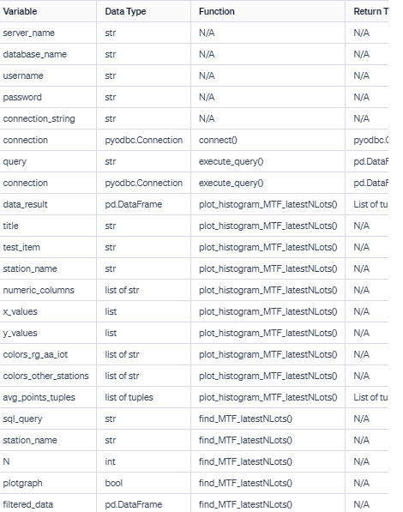
Objective: Code API Table and Summary
MTF_LatestNLots: API Table
Summary:
This Python script connects to a SQL Server database, executes a query to retrieve data for the top N travel cards, and plots histograms for specific test items. The main functions include connect for establishing a database connection, execute_query for running SQL queries and returning results as a Pandas DataFrame, and plot_histogram_MTF_latestNLots for generating histograms based on specified conditions.
The find_MTF_latestNLots function retrieves data for the top N travel cards from the database and, if specified, plots histograms for each unique test item.

Slide 10
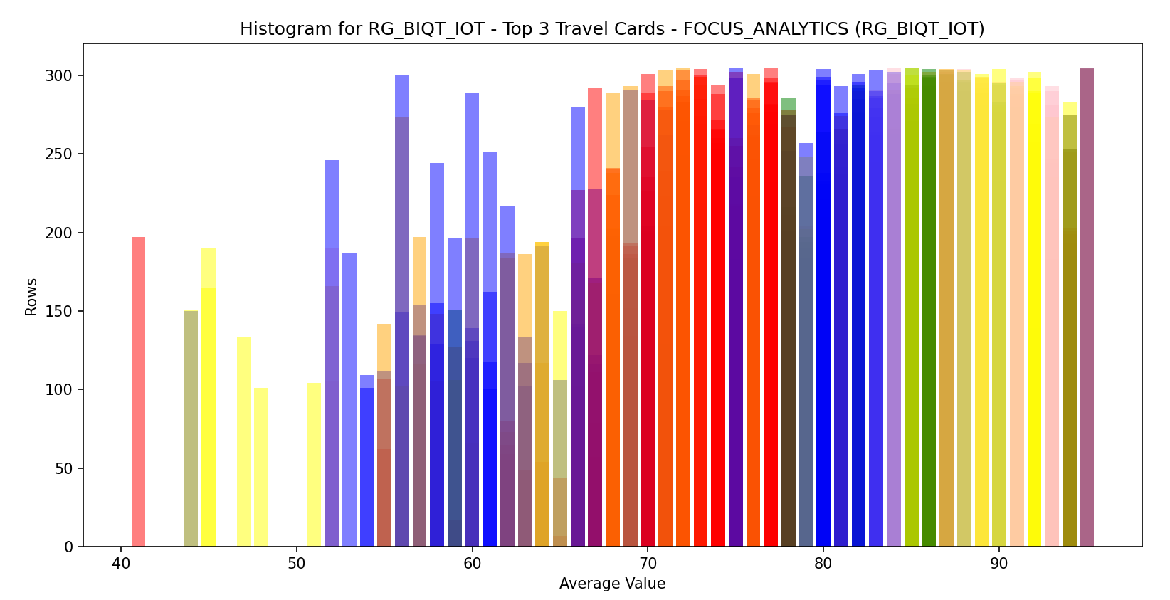
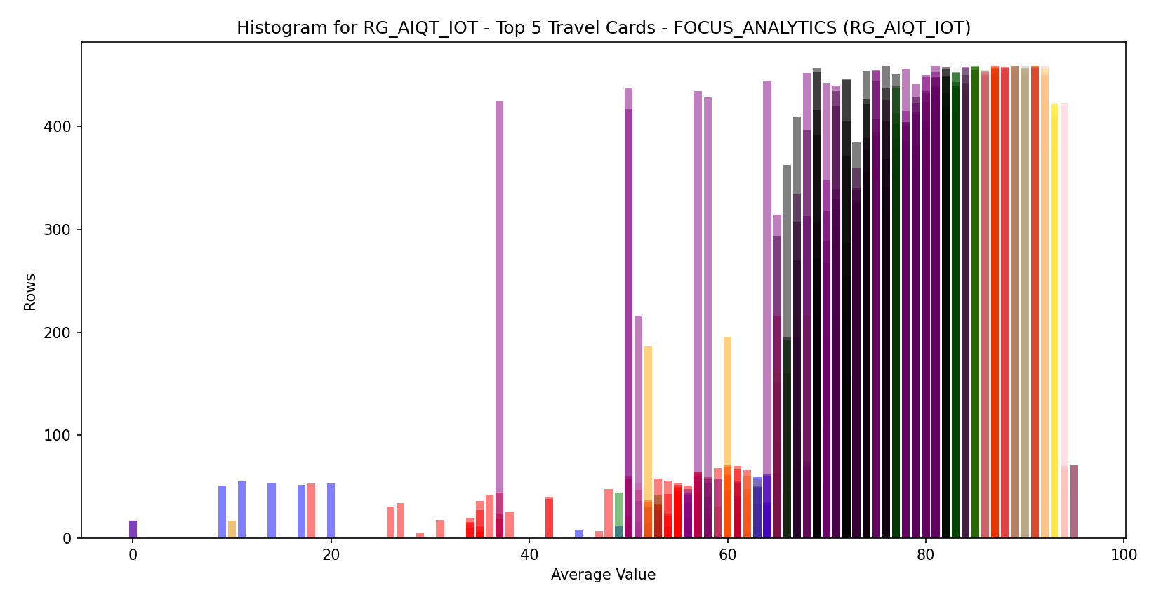
Objective: Code Output Graphs
MTF_LatestNLots: Output
station_name = 'RG_BIQT_IOT‘
N=3
station_name = 'RG_AIQT_IOT‘
N=5

Slide 11
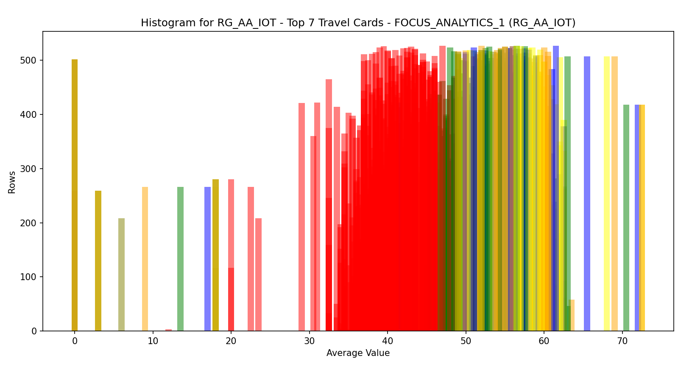
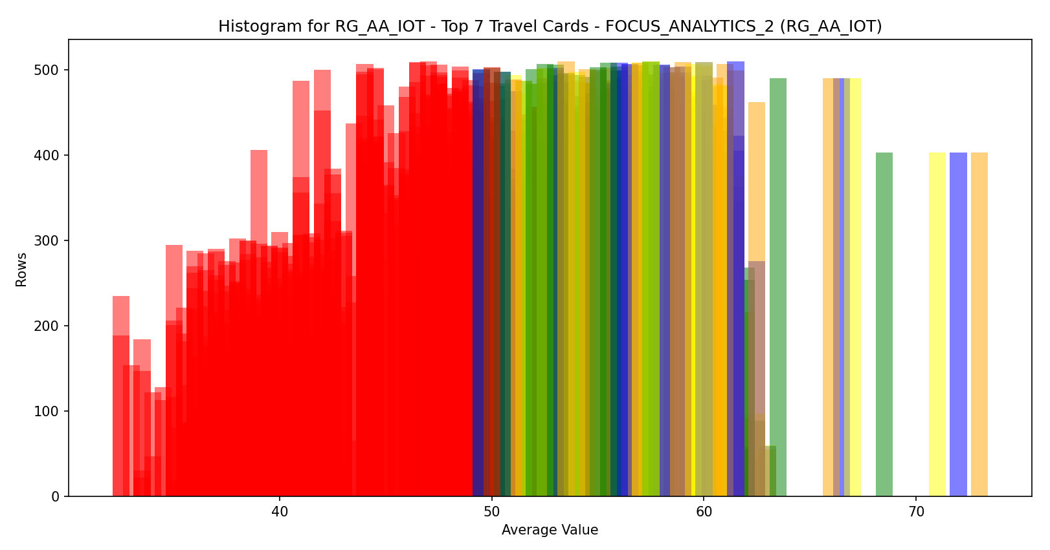
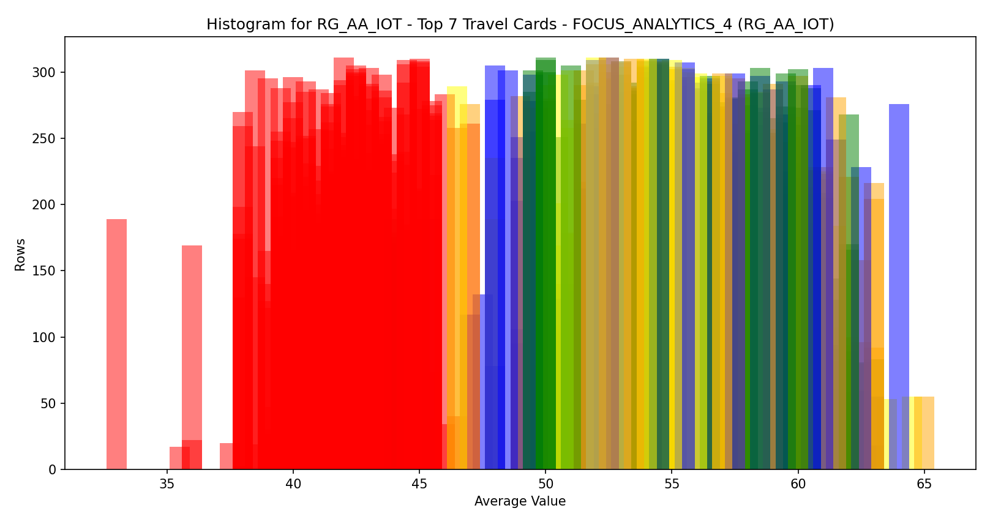
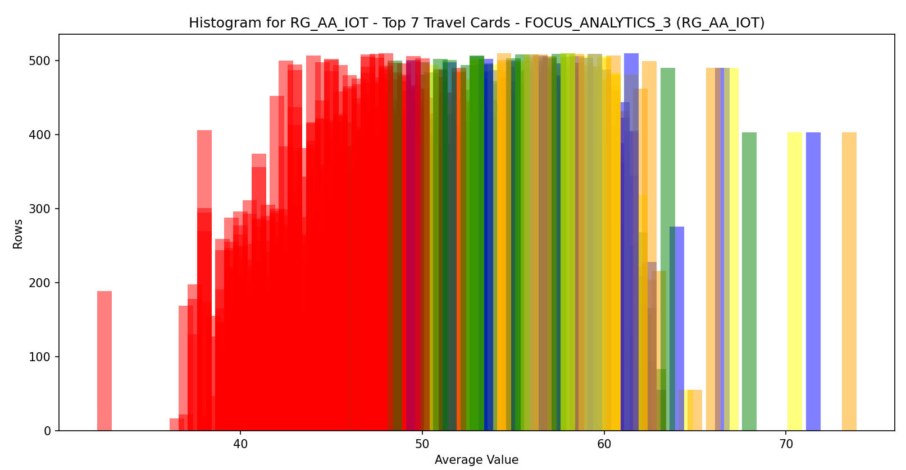
Objective: Code Output Graphs
MTF_LatestNLots: Output
station_name = 'RG_AA_IOT‘
N=7
station_name = 'RG_AA_IOT‘
N=7

Slide 12
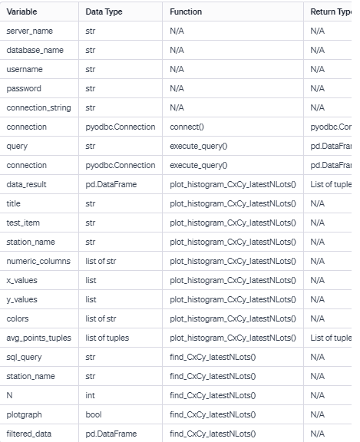
Objective: Code API Table and Summary
CxCy_LatestNLots: API Table
Summary:
This Python script connects to a SQL Server database, executes a query to retrieve data for the top N travel cards, and plots histograms for X and Y coordinates under the condition of a specific test item ('FOCUS_ANALYTICS'). The main functions include connect for establishing a database connection, execute_query for running SQL queries and returning results as a Pandas DataFrame, and plot_histogram_CxCy_latestNLots for generating histograms based on X and Y coordinate data.
The find_CxCy_latestNLots function retrieves data for the top N travel cards from the database and, if specified, plots histograms for X and Y coordinates related to the 'FOCUS_ANALYTICS' test item.

Slide 13
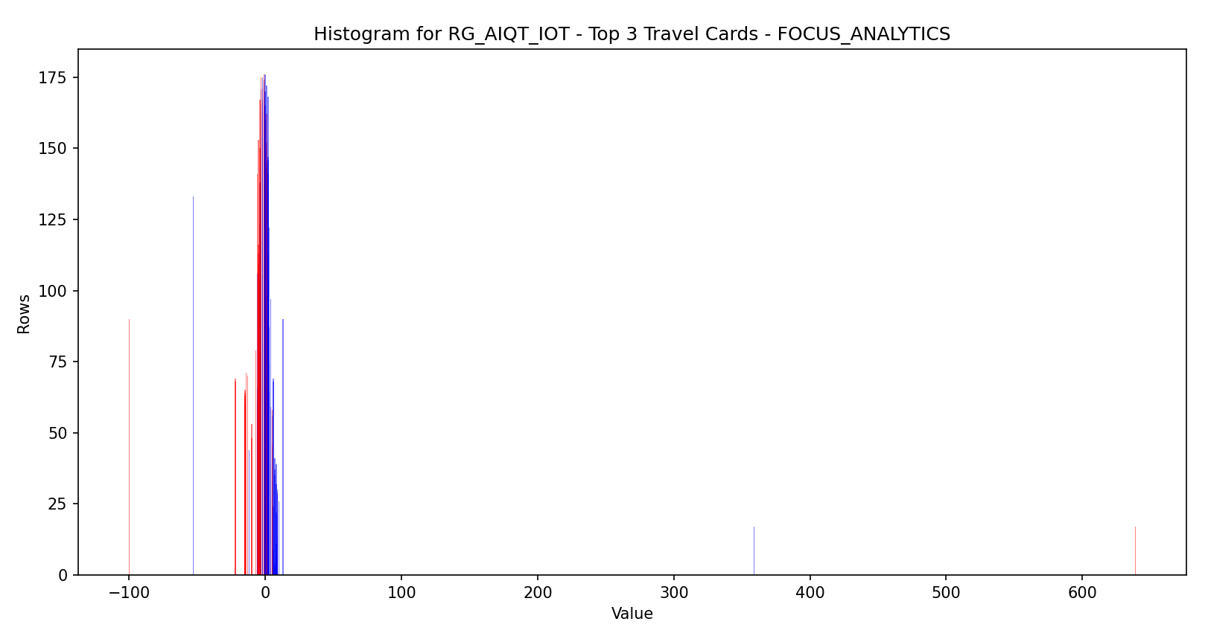
Objective: Code Output Graphs
CxCy_LatestNLots : Output
station_name = 'RG_AIQT_IOT‘
N=3

Slide 14
Thank You!
REC Technology
Corporation
瑞柯科技
股份有限公司

